Slide 1
ME 255 – Strength of Materials
Lecture 5: Bending In Beams II
By: Samuel Boahen (PhD)

Slide 2
Lecture Outline
Shear and Bending Moment Diagrams
Relation between the Shear force and the Bending Moment
Stresses in Beams

Slide 3
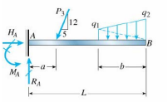
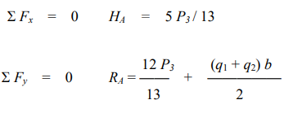

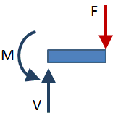

Cantilever Beam

Slide 4
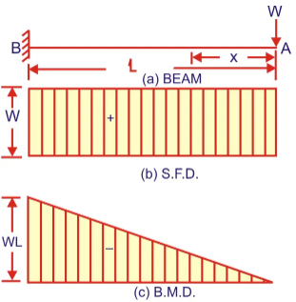
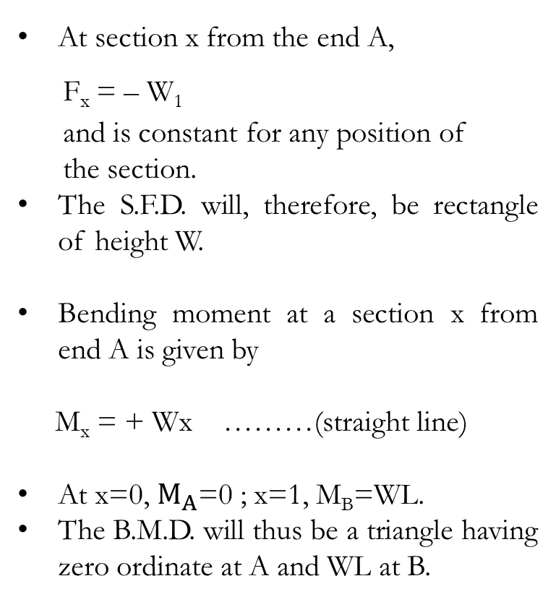
Bending Moment and Shear Force for Cantilever Beams
a) Cantilever with Point Load
At section x from the end A,
F_{x} = – W₁
and is constant for any position of
the section.
The S.F.D. will, therefore, be rectangle of height W.
Bending moment at a section x from end A is given by
M_{x} = + Wx ………(straight line)
At x=0, $M_{A}$=0 ; x=1, M_{B}=WL.
The B.M.D. will thus be a triangle having zero ordinate at A and WL at B.

Slide 5
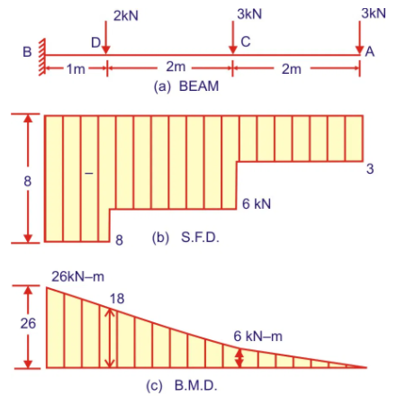
Cantilever with Several Point Loads
Shear Force Diagram
Between A and C,
F_{x}= – 3 kN (constant)
Between C and D,
F_{x} = -3-3=-6 kN (constant)
Between D and B,
F_{x} = -3-3-2=-8 kN (constant)
The S.F.D. will, therefore, consist of several rectangles having different ordinates.

Slide 6
Cantilever with Several Point Loads
Bending Moment Diagram
Between A and C,
M_{x} = 3x ….. (linear)
When x=0, M_{A}=0. When x=2m, M_{C}=3×2=6 kN.m
Between C and D.
M_{x}=3x+3(x-2) ……(linear)
When x=2, M_{C}=6 kN.m (as before)
When x=4, M_{D}=(3×4)+(3×2)=18 kN.m
Between D and B,
M_{x}=3x+3(x-2)+2(x-4) …… (linear)
When x=4, M_{D}=12+6=18 kN.m (as before)
When x=5, M_{B}=15+9+2=26 kN.m.
The B.M.D. is shown in (c).

Slide 7
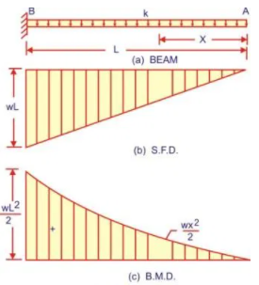
Cantilever with Uniformly Distributed Load over Whole Span
Shear Force Diagram
At any section x from A
F_{x}=-wx (linear)
When x=0, F_{A}=0 ; when x = L, F_{B} = – wL.
The S.F.D. will be triangle, as shown in
Fig. (b),
Bending Moment Diagram (parabolic)
When x=0, M_{A}=0 ; When x=L, .
The B.M.D. will be a parabola, as shown in (c).

Slide 8
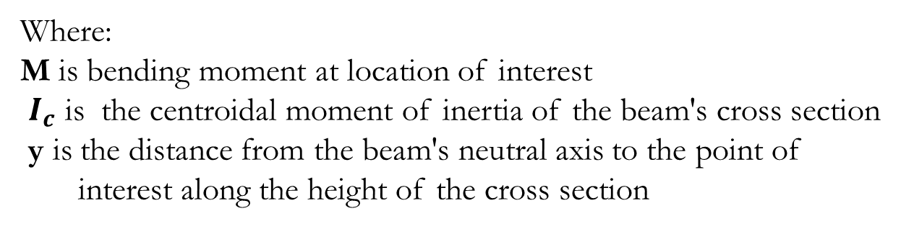
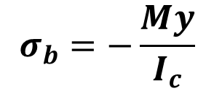
Bending Stresses In Beams
The bending moment, M, along the length of the beam can be determined from the moment diagram.
The bending moment at any location along the beam can then be used to calculate the bending stress over the beam's cross section at that location.
The bending moment varies over the height of the cross section according to the flexure formula below:
$$σ_{b}=−\frac{My}{I_{c}}$$
Where:
M is bending moment at location of interest
$I_{c}$ is the centroidal moment of inertia of the beam's cross section
y is the distance from the beam's neutral axis to the point of
interest along the height of the cross section

Slide 9
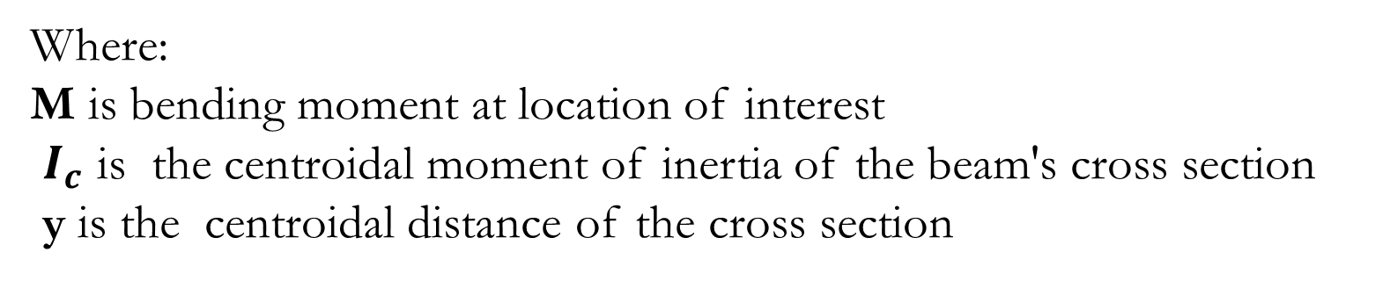
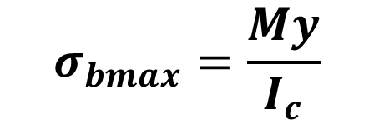
Bending Stresses In Beams
Maximum bending stress is given by
$$σ_{bmax}=\frac{My}{I_{c}}$$
Where:
M is bending moment at location of interest
$I_{c}$ is the centroidal moment of inertia of the beam's cross section
y is the centroidal distance of the cross section

Slide 10
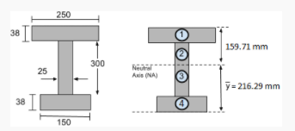
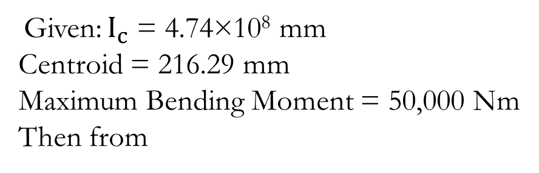
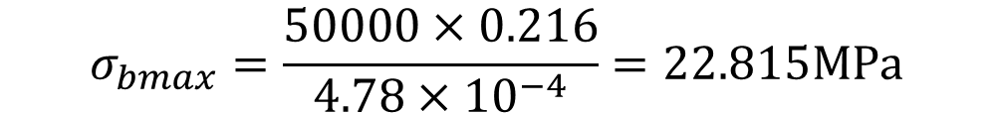
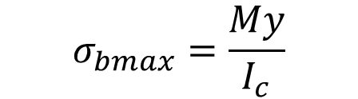
Example 1
Given: $I_{c}$ = 4.74×10⁸ mm
Centroid = 216.29 mm
Maximum Bending Moment = 50,000 Nm
Then from
$$σ_{bmax}=\frac{My}{I_{c}}$$
$$σ_{bmax}=\frac{50000×0.216}{4.78×{10}^{−4}}=22.815MPa$$

Slide 11
Example 2
A beam has a rectangular cross section 80mm wide and 100 mm deep. It is subjected to a bending moment of 15 kNm at a certain point along its length. It is made from metal with a modulus of elasticity of 180GPa. Calculate the maximum stress on the section.

Slide 12
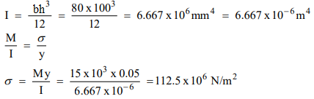
Solution
B = 80 mm, h = 100 mm. The value of y that gives the maximum
stress is therefore 50 mm.
c
c
c

Slide 13
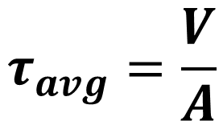
Shear Stresses In Beams
The shear force, V, along the length of the beam can be determined from the shear diagram.
The shear force at any location along the beam can then be used to calculate the shear stress over the beam's cross section at that location.
The average shear stress over the cross section is given by:
$$τ_{avg}=\frac{V}{A}$$

Slide 14
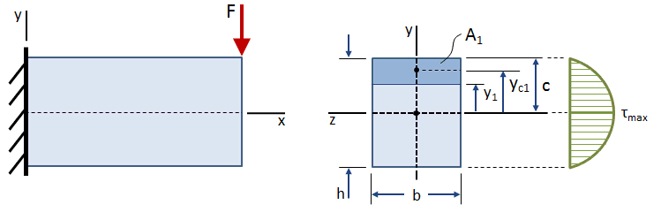
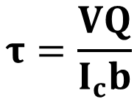
Shear Stresses In Beams
The shear stress varies over the height of the cross section, as shown in the figure below:
The equation for shear stress at any point located a distance y₁ from the centroid of the cross section is given by:
Where: V is the shear force acting at the location of the cross section,
Q is the first moment of the area
I_{c} is the centroidal moment of inertia of the cross section,
b is the width of the cross section.
$$τ=\frac{VQ}{I_{c}b}$$

Slide 15
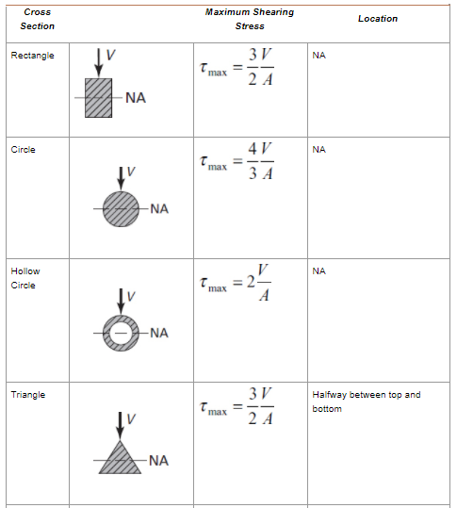
Shear stress for beams of various cross sections

Slide 16
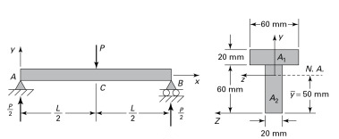
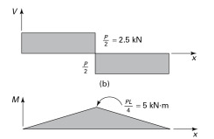
Example
A simply supported beam of length L carries a concentrated load P
(Fig. below). Find the maximum shear stress and bending stress.

Slide 17


Solution
The distance $\overline{y}$ from the z-axis to the centroid is calculated as
The maximum shearing stress in the beam takes place at the Neutral Axis on the cross section supporting the largest shear force V.
Consequently, Q_{NA} = 50(20)25 = 25×10³ mm³.
The shear force equals 2.5 kN on all cross sections of the beam

Slide 18

Solution
(b) The largest moment takes place at midspan, therefore

Slide 19
THANK YOU

Slide 20
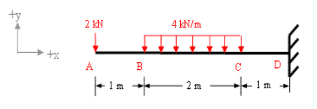
Tutorials
Determine the values and draw the bending moment and shear force diagrams for the beam below

Slide 21
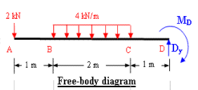


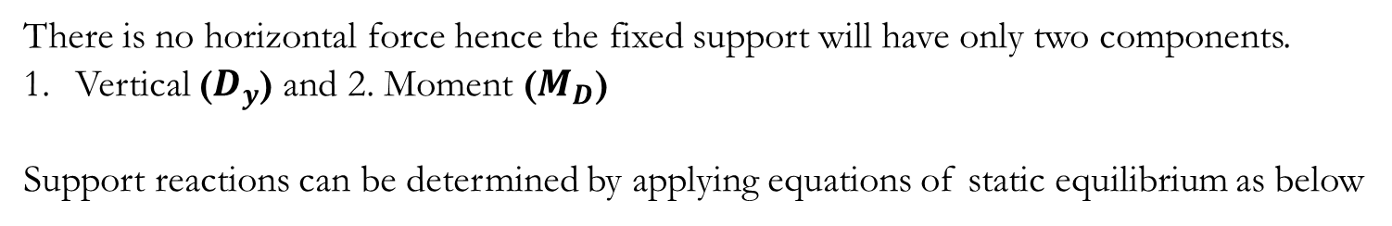
Solution
There is no horizontal force hence the fixed support will have only two components.
Vertical ($D_{y}$) and 2. Moment ($M_{D}$)
Support reactions can be determined by applying equations of static equilibrium as below

Slide 22
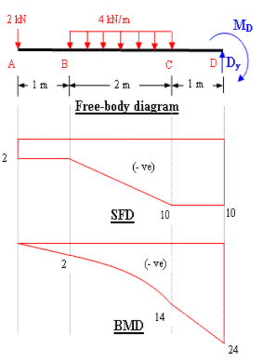
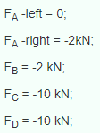
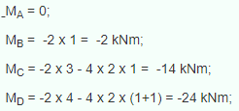
Solution
Shear force Calculation
Bending Moment Calculation

